Slide 1





Echoes
Turning Silence into Voice
Syed Hur Ali Rizvi
24K-0615

Slide 2
Features
01.
02.
Gesture to Text Conversion
Text to Gesture Image
03.
04.
Text-to-Speech
Speech-to-Text

Slide 3
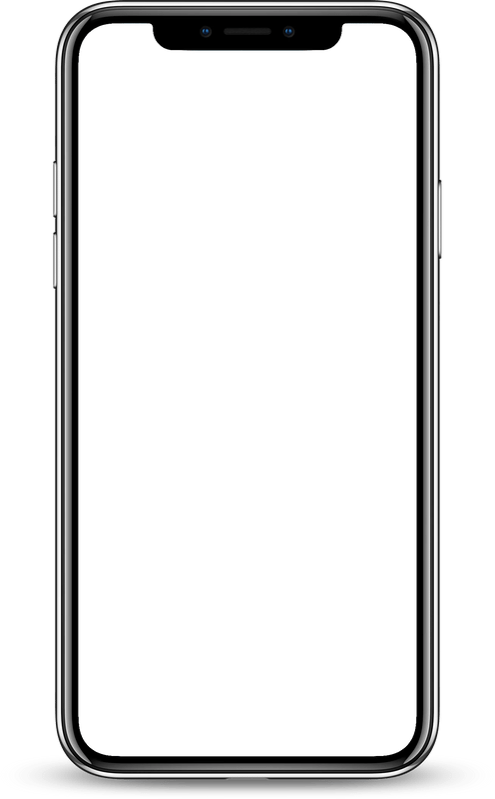
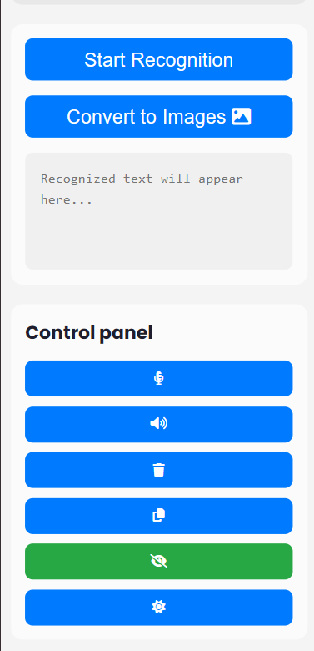
Communication Bridge
Accessibility
It converts each gesture into the corresponding ASL letter, displaying the letter as text.
This helps people with hearing or speech impairments communicate with ease.
It also has a text-to-speech feature that reads the recognized text aloud for better accessibility.
These features make the app a versatile communication tool for those with disabilities.
Learning ASL
Independence
For each letter in the sentence, it shows an image of the corresponding ASL hand gesture. This feature supports learning and understanding of ASL through visual representation
Helps deaf individuals communicate freely, while blind users can navigate the app with voice commands and text-to-speech features.

